Slide 1

TCS STUDENT FEE REMINDER SYSTEM PROTOTYPE
An Automated Solution for Timely Fee Collection
BY RISHI SINGH UNDER THE GUIDANCE OF ER. ASAD BEG

Slide 2
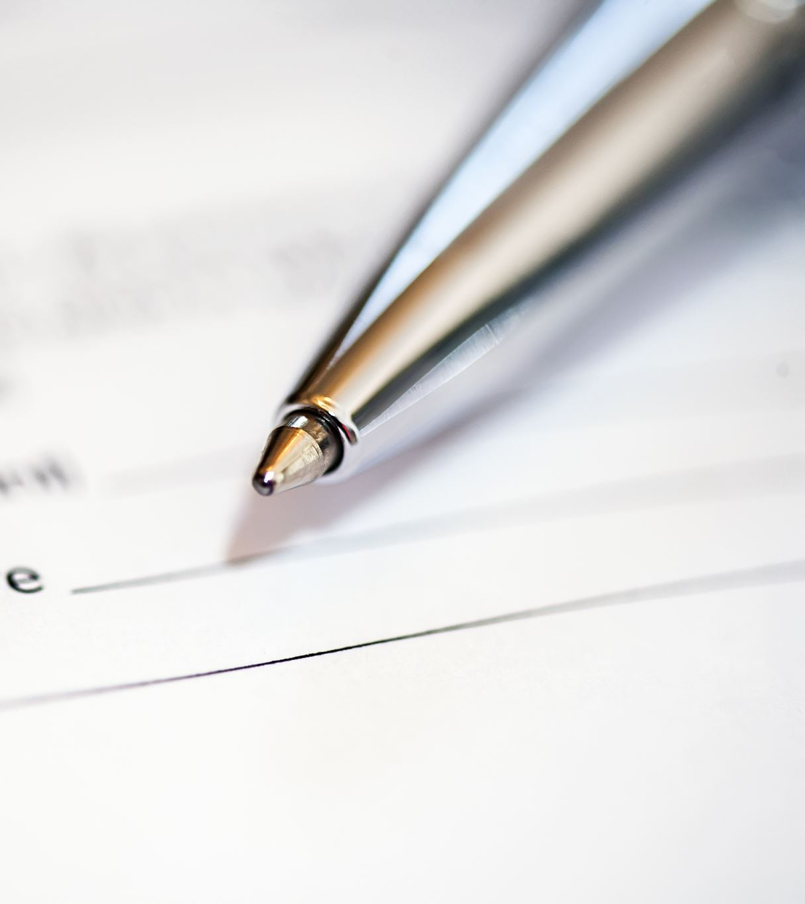
The Challenge: Manual Fee Reminders
Manually tracking student due dates is time-consuming and prone to human error.
Late payments negatively impact an institution's cash flow.
Sending individual reminders is inefficient and lacks personalization.

Slide 3
Our Solution: A Smart Reminder Application
We developed a simple web application to automate the entire reminder process.
Upload: The administrator uploads a single Excel file with student data.
Process: The system instantly analyzes the data and identifies who needs a reminder.
Notify: Personalized email reminders are sent automatically.

Slide 4
The Core Logic: From Data to Reminder
The application follows a clear, four-step workflow to ensure no student is missed.
Step 1: Data Input
A user-friendly web page to upload the student fee data.
Step 2: Processing & Calculation
The backend calculates each student's unique due date.
Step 3: Bifurcation (Categorization)
It determines the payment status for every single student.
Step 4: Automated Notification
It triggers customized emails to the right students at the right time.

Slide 5

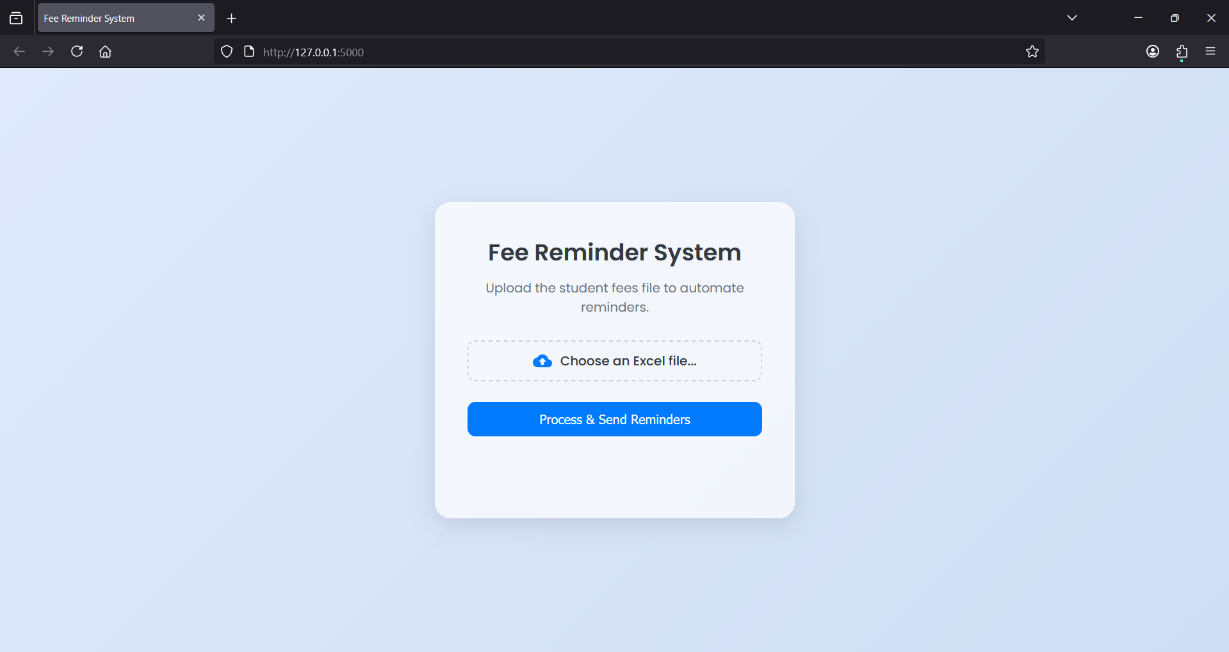
A Clean and Simple Starting Point
The process begins with our user-friendly web interface. The only action required from the administrator is to choose the student fees Excel file.

Slide 6

The "Brain": Processing and Calculation
Once uploaded, the Python backend takes over. It intelligently calculates the Next Due Date for each student based on their last payment and their payment plan (Annual or Semi-Annual).Due Date = Last Payment Date + Plan Duration

Slide 7
Bifurcation: Who Needs a Reminder?
Status | Condition | Action
Paid | Due in > 30 days | No Reminder
Due Soon | Due within 30 days | Send Reminder
Overdue | Past due by 1-15 days | Send Reminder
Severely Overdue | Past due by > 15 days | Send Reminder
The system compares the calculated Due Date with today's date and assigns a status to categorize every student. An email is sent only to those who need it.

Slide 8
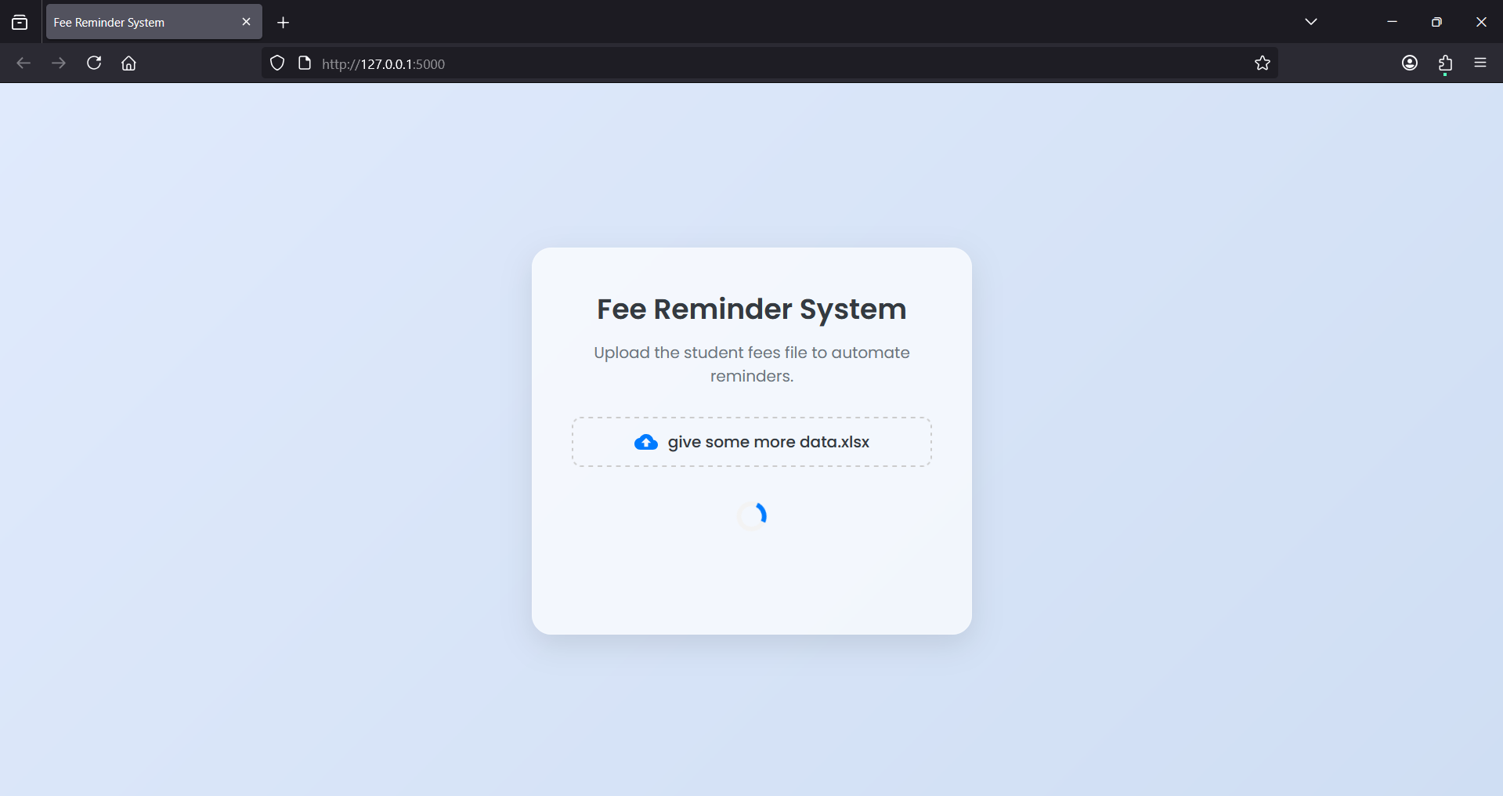
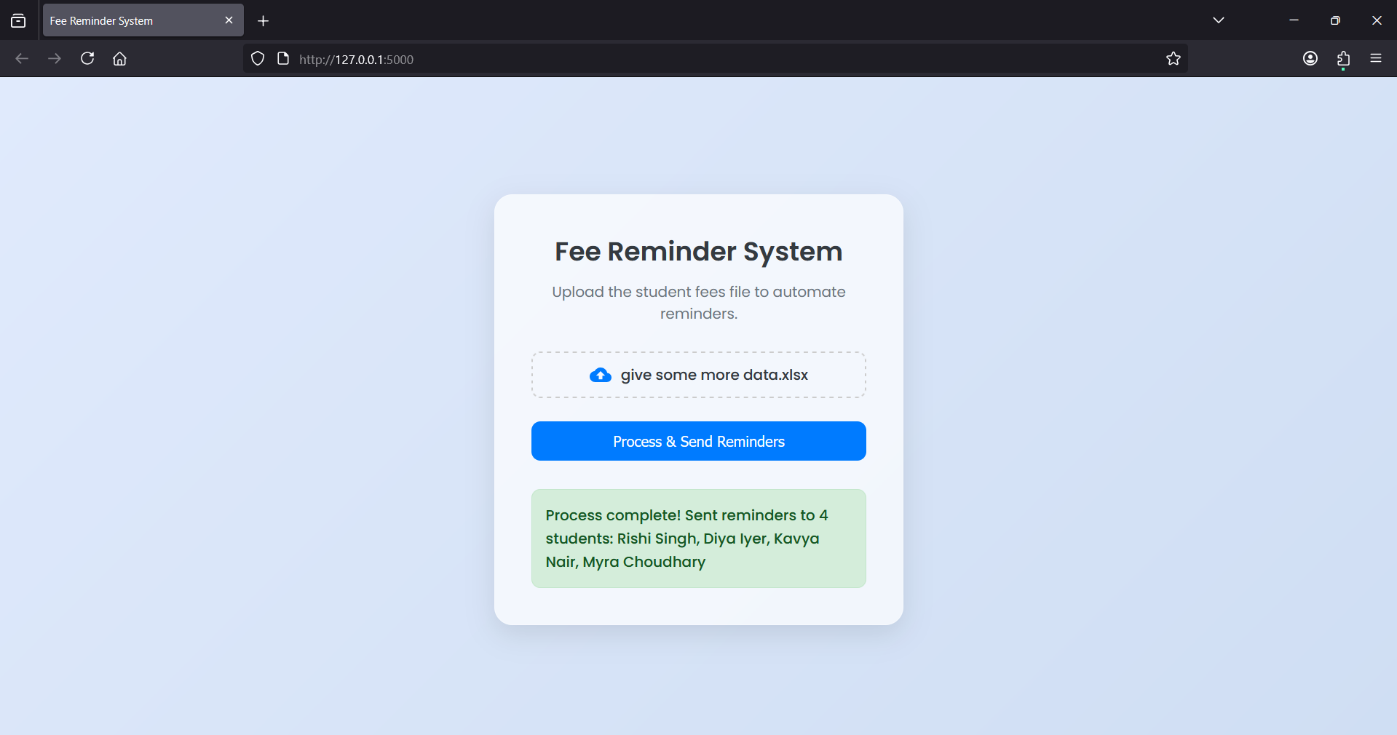
Walking Through the Process

Slide 9
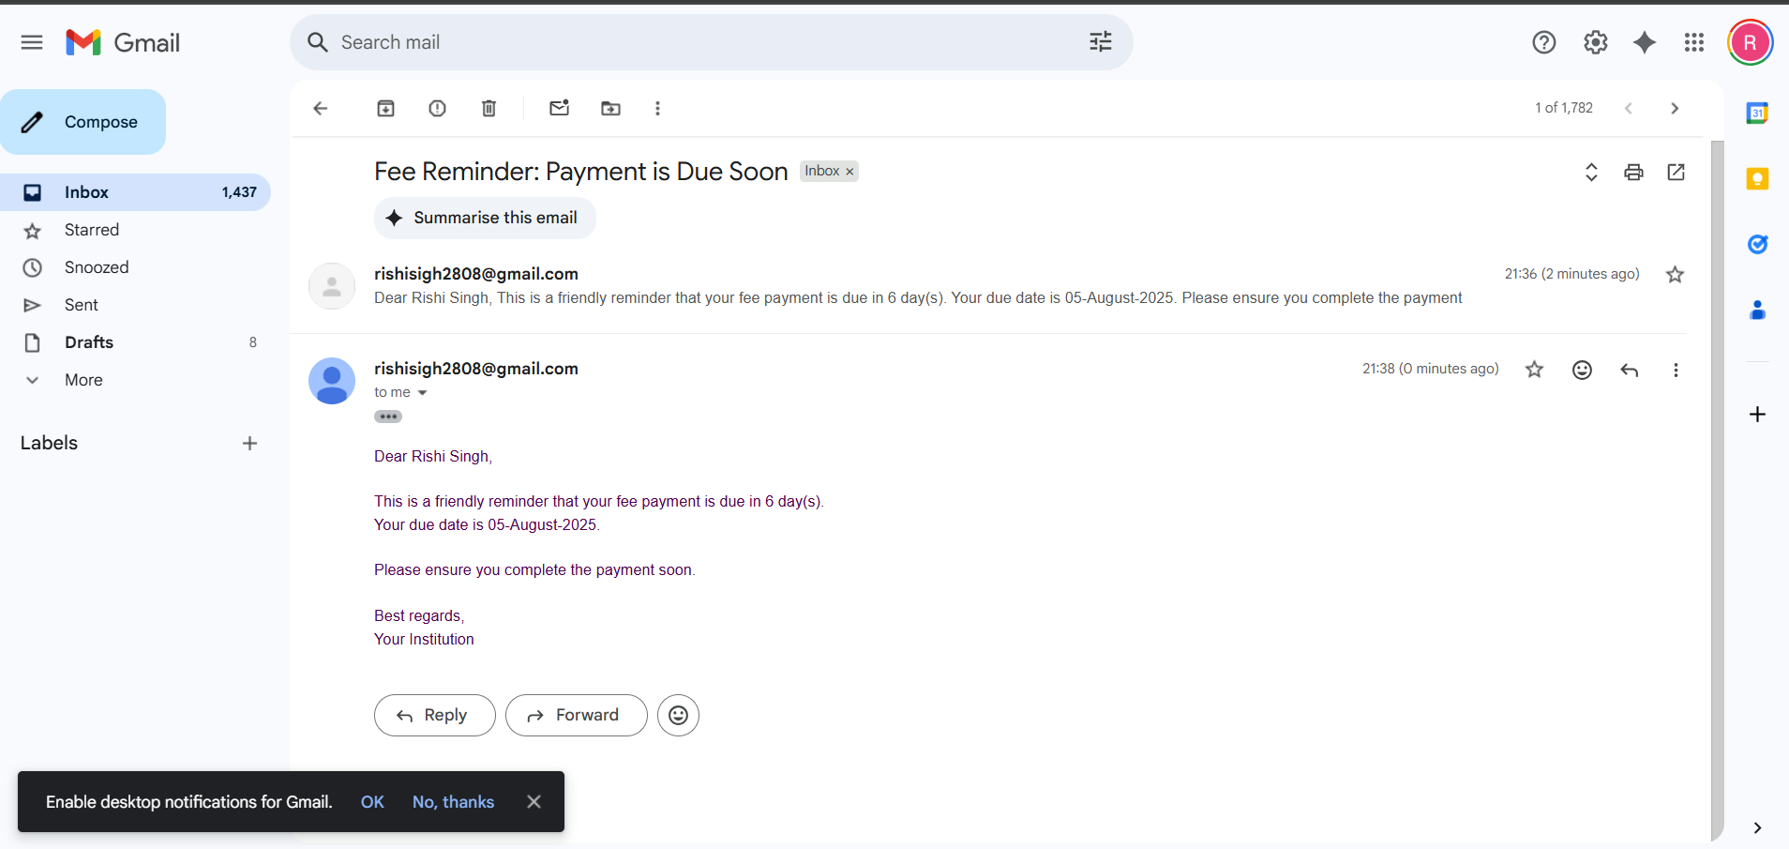
The Result: A Real Email in the Inbox
The most important part: the system delivers a real, personalized reminder directly to the student's inbox. This confirms the automation is successful from start to finish.

Slide 10
Conclusion & What's Next
Conclusion: This system successfully automates the fee reminder process, saving administrative time, reducing errors, and improving timely fee collection.
Future Enhancements:
Integrate a payment gateway link directly in the email.
Develop a dashboard to visualize payment statuses and trends.
Use Machine Learning to predict which students are at high risk of defaulting for proactive reminders.

